Slide 1
Are Hate Crimes correlated to other factors?
TEAM E: NABIL, DUSTIN, JESSICA, DAN
OCTOBER 27, 2018

Slide 2
Background
Asked different nonprofit workers for worthy projects
Received a request to map different economic factors onto different states (for a nonprofit that works on income inequity)
Decided to compare different economic indicators against discrimination
Used hate crimes as proxy for overall discrimination rates

Slide 3
For each participating U.S. state, we wanted to compare Hate Crimes to:
State Debt
Employment Rate
Education Level
Median Household Income

Slide 4
Data sources
census.gov
FBI Uniform Crime Reporting (UCR)
Education Week
fivethirtyeight.com

Slide 5
Hate Crime Data Discovery
Aggregated by State; 5-year average (2012 – 2016); Normalized by reporting agency population
Source:
Data from FBI Uniform Crime Reporting (UCR) website. Aggregation of all self-reporting agencies in US. Most uniform list.
Alternate Source (did not use):
Did not use Southern Poverty Law Center (SPLC) for continuity and potential overlap with FBI #s.
Definitions:
Hate Crimes (prosecutable) vs. Hate Incident (could be protected under free speech).
Agencies are law enforcement agencies.

Slide 6


Slide 7
Plotly Choropleth Heat Maps
Need to register for free Plotly account to use:
Plotly api_key
Choropleth heat map code example converts all data to STR, then single data frame into DICTS for data and legend then plots.
Looks more complicated than it actually is.
Hate Crime Incidents normalized by population so that CA would not be unfairly weighted.
Normalized HC Incidents = (Number of Hate Crime Incidents / Agency Population ) * 1M

Slide 8
Demo

Slide 9
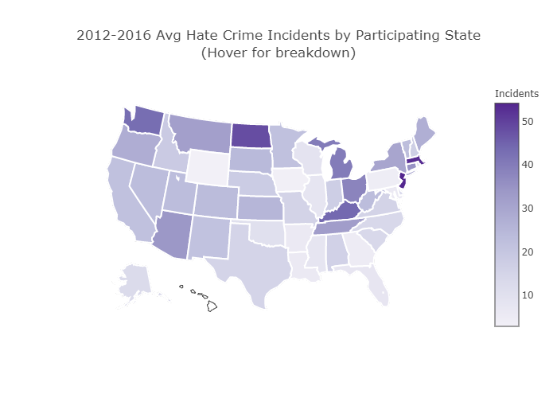

Slide 10
Hate Crime Results
Highest Average by State (2012 – 2016):
New Jersey (54.1)
Massachusetts (53.3)
North Dakota (48.8)
Kentucky (44.3)
Washington (40.3)

Slide 11
Median Household Income Data Discovery
Median Household Income conveniently already came in .csv from census.gov as a five-year average.

Slide 12
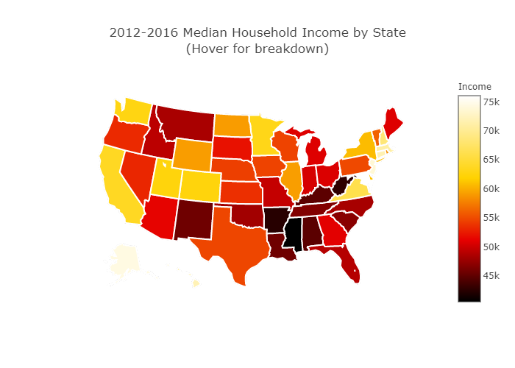

Slide 13
Median Household Income Results
Lowest Average by State (2012 – 2016):
Mississippi (41k)
Arkansas (42k)
West Virginia (43k)
Alabama (45k)
Kentucky (45k)

Slide 14
Hate Crime vs Median Household Income

Slide 15
Hate Crime & Household Income Correlation?
TOP FIVE HATE CRIME INCIDENT STATES (10% OF POP.)
BOTTOM FIVE MEDIAN HOUSEHOLD INCOME STATES (10% OF POP.)
New Jersey (54.1)
Massachusetts (53.3)
North Dakota (48.8)
Kentucky (44.3)
Washington (40.3)
Mississippi (41k)
Arkansas (42k)
West Virginia (43k)
Alabama (45k)
Kentucky (45k)

Slide 16

THERE IS HEAT ON KENTUCKY!!

Slide 17
Education Data Discovery
State by State 2015-16 Graduation Rates
Source:
Education Week Research Center Analysis of NCES data, 2017
Definitions:
Public high school 4-year adjusted cohort graduation rate (ACGR), for the United States, the 50 states, and the District of Columbia: School year 2015–16

Slide 18
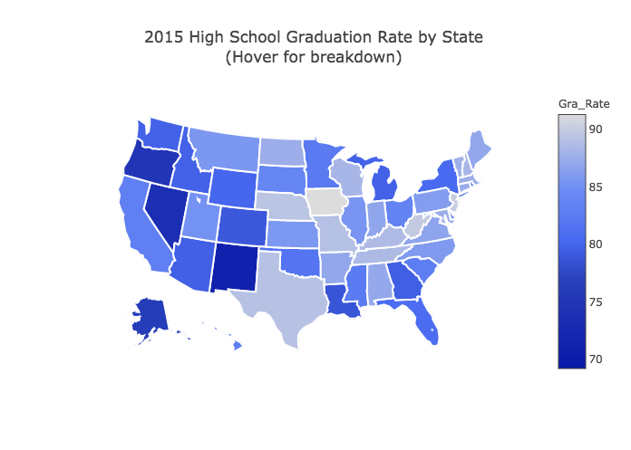

Slide 19
Education Results
Lowest High School Graduation Rate by State 2016:
New Mexico (71.8)
Nevada (73.6)
Oregon (74.8)
Arkansas (76.1)
Louisiana (78.6)
*to be consistent with hate crime data, the data excludes DC

Slide 20
Hate Crime vs. Education Analysis
[Previous slide is both heatmaps side by side.]
Insert findings here.

Slide 21
Hate Crime & Education Correlation?
TOP FIVE HATE CRIME INCIDENT STATES (10% OF POP.)
BOTTOM FIVE HIGH SCHOOL GRADUATION RATE STATES (10% OF POP.)
New Jersey (54.1)
Massachusetts (53.3)
North Dakota (48.8)
Kentucky (44.3)
Washington (40.3)
New Mexico (71.8)
Nevada (73.6)
Oregon (74.8)
Arkansas (76.1)
Louisiana (78.6)
Keep Calm and No Relationship(peace)(smiley face)(heart)

Slide 22
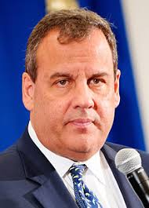
Hate Crime & Education Correlation?
TOP FIVE HATE CRIME INCIDENT STATES (10% OF POP.)
Highest FIVE HIGH SCHOOL GRADUATION RATE STATES (10% OF POP.)
New Jersey (54.1)
Massachusetts (53.3)
North Dakota (48.8)
Kentucky (44.3)
Washington (40.3)
Iowa (91.3)
New Jersey (90.2)
West Virginia (89.8)
Nebraska (89.3)
Texas (89.1)

Slide 23
Employment Data Discovery
Average by state; 2015.
Source:
US Census American Fact Finder website.
Debate over different measures of unemployment; Bureau of Labor Statistics U6 generally considered most comprehensive but unable to make API work.
Used Census employment data instead.

Slide 24
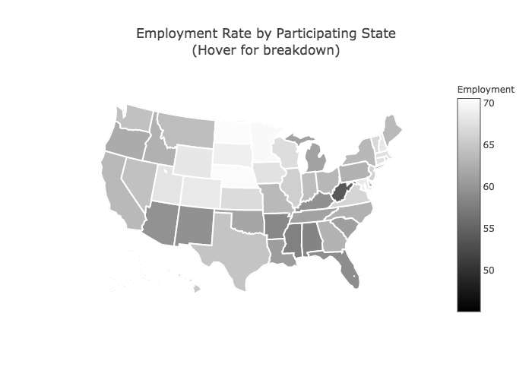

Slide 25
Employment Rate Results
Lowest Average by State (2015):
West Virginia (53.9%)
Mississippi (58%)
Alabama (58.3%)
Arkansas (58.7%)
Florida (59.2%)

Slide 26
Hate Crime vs Median Household Income

Slide 27
Hate Crime & Employment Rate Correlation?
TOP FIVE HATE CRIME INCIDENT STATES (10% OF POP.)
BOTTOM FIVE EMPLOYMENT RATE STATES (10% OF POP.)
New Jersey (54.1)
Massachusetts (53.3)
North Dakota (48.8)
Kentucky (44.3)
Washington (40.3)
West Virginia (53.9%)
Mississippi (58%)
Alabama (58.3%)
Arkansas (58.7%)
Florida (59.2%)

Slide 28

There is no heat.

Slide 29
State Debt Data Discovery
Aggregated by State; 2015
Source:
Came in an easy to use .csv from census.gov
Definitions:
All loans that the State has issued/backed

Slide 30
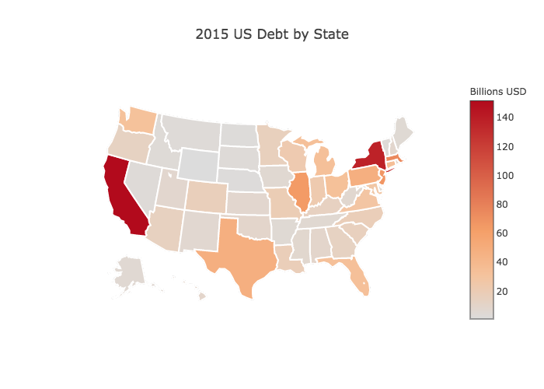

Slide 31
State Debt Results
Top Debt by State (in billions):
California ($151.72)
New York ($137.37)
Massachusetts ($75.31)
New Jersey ($67.17)
Illinois ($64.21)

Slide 32
Hate Crime vs State Debt

Slide 33
Hate Crime vs. State Debt Correlation
TOP FIVE HATE CRIME INCIDENT STATES (10% OF POP.)
TOP FIVE STATES WITH MOST DEBT ($B)
New Jersey (54.1)
Massachusetts (53.3)
North Dakota (48.8)
Kentucky (44.3)
Washington (40.3)
California ($151.7)
New York ($137.4)
Massachusetts ($75.3)
New Jersey ($67.2)
Illinois ($62.2)

Slide 34


DOUBLE HEAT IN
NEW JERSEY AND MASS!!

Slide 35
Is a t-test necessary?
Plotted 2012 – 2016 data to box plot to see if the medians were different from each other.
First glance shows the medians all very similar.

Slide 36
Demo in Jupyter Notebook

Slide 37
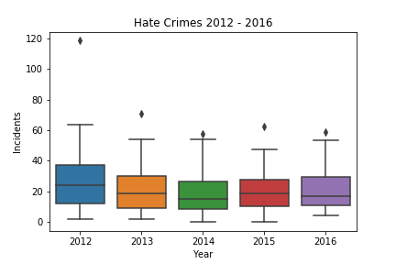

Slide 38
Demo in Jupyter Notebook

Slide 39
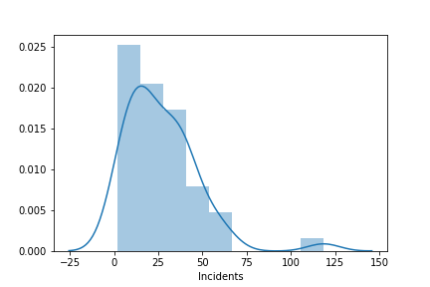
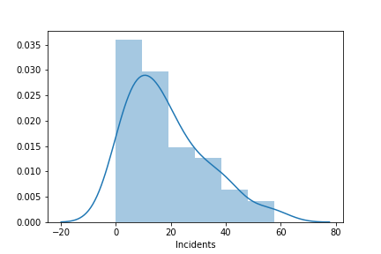
Welch’s t-test results
NULL HYPOTHESIS ASSUMES MEANS ARE EQUAL BY CHANCE. P-VALUE < 0.05, THEREFORE THE MEANS ARE SIGNIFICANTLY DIFFERENT, SO WE REJECT THE NULL HYPOTHESIS.

Slide 40
T-test between highest and lowest median years (2012, 2014)
Conducted Welch’s ttest as they were two independent populations.
Result: P-value is <.05 therefore the null hypothesis that the means should be the same is not statistically likely. So we reject the null hypothesis; there is no correlation between the incidents in 2012 and 2014.

Slide 41
...however, doing an ANOVA for
2012 - 2016
Conducted Welch’s ttest as they were two independent populations.
Result: P-value > 0.05 therefore we accept the null hypothesis that the means are significantly similar across all five years.

Slide 42
Demo in Jupyter Notebook

Slide 43
Overall Findings
There is a correlation between Hate Crimes and State Debt and Median Income Inequality. However:
Is the correlation for state debt only for 2015, or does it change for 2012 - 2016?
Same question for Education and Employment. Would their five year averages have a correlation to Hate Crimes?
Therefore further research is needed.
Box plot showing very similar medians = the null hypothesis that their means were equal is highly likely. Confirmed in ANOVA. However:
Choosing the most disparate individual groups (2012 and 2014) revealed that their means were not statistically likely.
Therefore ANOVA and T-tests could show opposite results which are both correct depending upon the data you include.

Slide 44
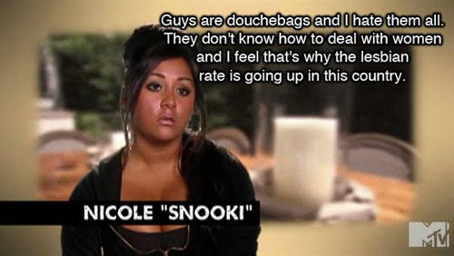

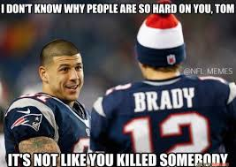

New Jersey
Massachusetts
Kentucky

Slide 45
Challenges
Hate Crimes:
Multiple Years (2015 vs 5-year avg); Hate Crime vs Incident Definition; voluntary agency submissions; no data from Hawaii; possible “awareness bias” in Massachusetts; addendum in 2012 to data possible reason for high overall number in New Jersey
Employment:
Bureau of Labor Statistics API
Education:
To use public high school graduation rate as the only indicator may not be sufficient to conclude the education has no relationship with hate crime.
State Debt:
In regards to debt, normalizing by population may garner further insight into which states have more ‘true’ debt.

Slide 46
Improvements for the future
Use draft folder separate from folder to push to GitHub.
Don’t “add .” to github, add only relevant files to GitHub.
Besides the heatmap, statistical correlation tests could be used to test the relationship between factors and hate crimes.
Bias in how we analyzed data. We could have looked at correlations in the opposite direction of what we assumed:
higher hate crimes with higher education, employment, income and lower state debt?

Slide 47
Contributions
Jessica: Education analysis, graduation rate heat map, draft PPT
Nabil: Geopandas plot, failed BLS API, Employment analysis
Dustin: State debt analysis, state debt heat map
Dan: Hate Crimes and Median Income data and plots, ttest, Git master

Slide 48

Q&A

Slide 49

Thank you!

